Slide 1
pharma marketing and data science
June 3, 2020
Jemma rong

Slide 2
What is DTC in Healthcare?
Definition: Direct-to-consumer healthcare mainly consists of products and services that consumers can access without having to go through an intermediary (medical professionals or healthcare companies).
Advantages:
Personalized and helpful customer service
Products delivered straight to the door
Disadvantages:
Budget allocation for ads

Slide 3
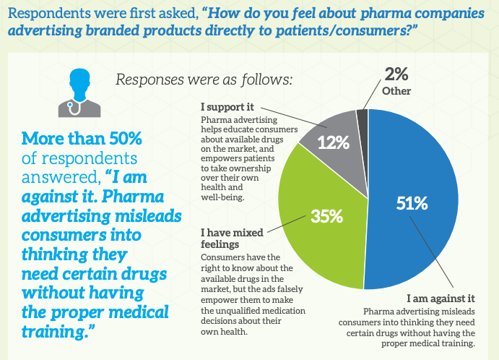
What is DTC in Healthcare?
Criticism: More than 50% of respondents who are physicians answered, “I am against it. Pharma advertising misleads consumers into thinking they need certain drugs without having the proper medical training.” (MedData)

Slide 4
What is HCP?
“HCP” refers to all paid and unpaid persons serving in healthcare settings who have the potential for direct or indirect exposure to patients or infectious materials, including body substances (e.g., blood, tissue, and specific body fluids); contaminated medical supplies, devices, and equipment; contaminated environmental surfaces; or contaminated air.
HCP includes emergency medical service personnel, nurses, nursing assistants, physicians, technicians, therapists, phlebotomists, pharmacists…

Slide 5
Current Trend of Healthcare Consumers Movement
Trend 1: Healthcare consumers most often turn to the Internet FIRST for health-related information (57% vs 32%), including treatment information. (DotHealth 2017)

Slide 6
Current Trend of Healthcare Consumers Movement
Trend 2: 53 percent of HCPs and 54 percent of consumers believe pharma ads prime them to have better shared dialogue, according to Media Vitals research.
Question: How to let patients and healthcare providers get to the same page?
Answer: Integration
Key Challenge:
Budget allocation (Target Marketing instead of Mass Marketing)
Database (?) ➔ Segmentation ➔ Targeting ➔ Positioning➔ Marketing Mix

Slide 7
How about integrating DTC MKT with HCP MKT?
Solution:
Deliver to the target audiences of curated healthcare provider networks
Track and report down to the NPI (National Provider Identifier) level
Comprehensive database: multiple source, link them together
Following steps (all with machine learning!)
Segmenting the market
Predicting Patients behavior
Identifying potential customers who are most valuable
Market Mix Modeling (or Promotion Response Modeling)

Slide 8
References
https://www.cdc.gov/infectioncontrol/guidelines/healthcare-personnel/introduction.html
https://www.klick.com/health/news/blog/strategy/five-reasons-why-consumer-marketing-matters-to-pharma/
https://www.audicus.com/direct-to-consumer-healthcare/
https://www.pharmalive.com/how-to-leverage-dtc-and-hcp-integration-for-better-branding-results/

Slide 9
THANK YOU!

